Slide 1
Neural Network and Deep Learning 23CS8PENDL/23CS7PENDL

Slide 2
Unit-2
Multilayer Perceptron: Introduction, Batch Learning and on-line Learning, The Back- Propagation Algorithm, The Hessian and its Role in On-Line Learning, Generalization, Approximation of Functions, Cross-Validation, Complexity Regularization and Network Pruning, Supervised Learning viewed as an Optimization, Non-Linear Filtering

Slide 3
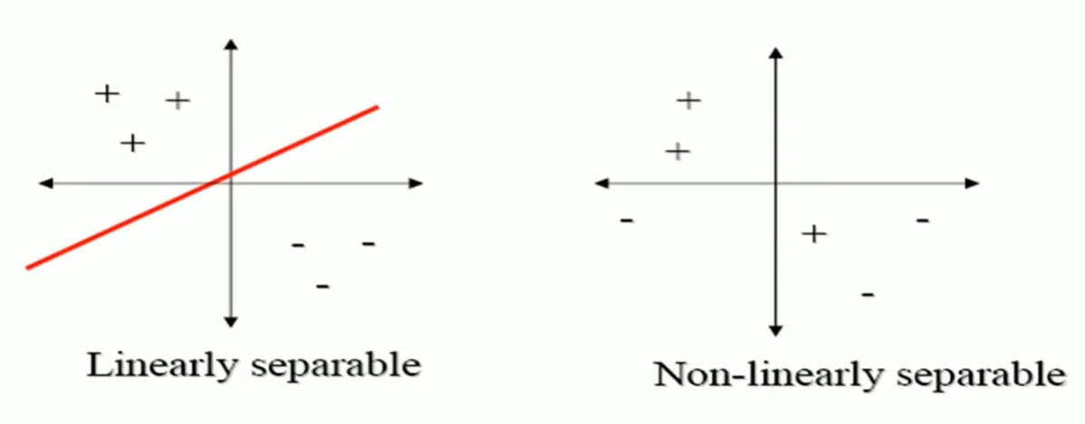
Linear Neurons and Limitations
The perceptron can only model linearly separable functions, − those functions which can be drawn in 2-dim graph and single straight line separates values in two part.
Boolean functions given below are linearly separable: − AND − OR − COMPLEMENT
It cannot model XOR function as it is non linearly separable. − When the two classes are not linearly separable, it may be desirable to obtain a linear separator that minimizes the mean squared error.

Slide 4
XOR – Non linearly separable function
A typical example of non-linearly separable function is the XOR that computes the logical exclusive or..
This function takes two input arguments with values in {0,1} and returns one output in {0,1},
Here 0 and 1 are encoding of the truth values false and true,
The output is true if and only if the two inputs have different truth values.
XOR is non linearly separable function which can not be modeled by perceptron.
For such functions we have to use multilayer perceptron.

Slide 5
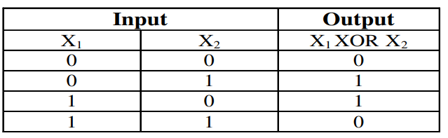
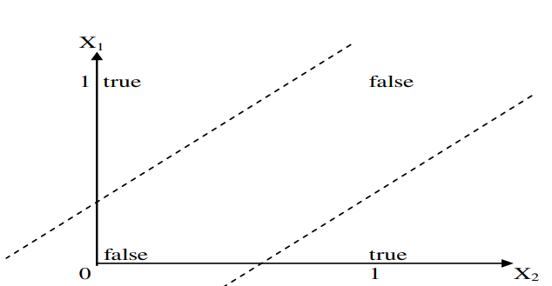
XOR – Non linearly separable function
These two classes (true and false) cannot be separated using a line. Hence XOR is non linearly separable.

Slide 6
Multilayer Perceptron
To overcome the practical limitations of the perceptron and the LMS algorithm, we look to a neural network structure known as the multilayer perceptron.
The following three points highlight the basic features of multilayer perceptrons:
• The model of each neuron in the network includes a nonlinear activation function that is differentiable.
• The network contains one or more layers that are hidden from both the input and output nodes.
• The network exhibits a high degree of connectivity, the extent of which is determined by synaptic weights of the network.

Slide 7
Question: Multilayer Perceptron
Explain the three basic features of the multilayer perceptron and the two phases of training by back-propagation algorithm with LMS as a special case.

Slide 8
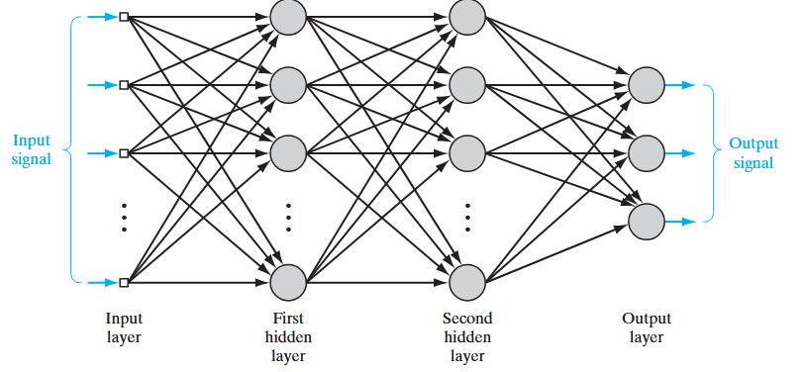
Architectural graph of a multilayer perceptron
Architectural graph of a multilayer perceptron with two hidden layers
Notes:
To set the stage for a description of the multilayer percep-tron in its general form, the network shown here is fully connected. This means that a neu-
ron in any layer of the network is connected to all the neurons (nodes) in the previous layer. Signal flow through the network progresses in a forward direction, from left to right
and on a layer-by-layer basis.

Slide 9
Architectural graph of a multilayer perceptron (MLP)
A multilayer perceptron (MLP) is a perceptron that teams up with additional perceptron stacked in several layers, to solve complex problems.
Each perceptron sends multiple signals, one signal going to each perceptron in the next layer.
For each signal, the perceptron uses different weights.
The multilayer perceptron has another, more common name—a neural network.
• A three-layer MLP is called a Non-Deep or Shallow Neural Network.
• An MLP with four or more layers is called a Deep Neural Network.
Classic Perceptron Vs. A Neural Network:
• In a classic perceptron, the decision function is a step function and the output is binary.
• In neural networks that evolved from MLPs, other activation functions can be used, usually between 0 and 1 or between -1 and 1.
• This allows for probability-based predictions or classification of items into multiple labels.
A Multilayer Perceptron (MLP) is a feedforward artificial neural network consisting of multiple layers of interconnected neurons.
Input Layer: Each neuron or node in this layer corresponds to an input feature. For instance, if you have three input features the input layer will have three neurons.
Hidden Layers: MLP can have any number of hidden layers with each layer containing any number of nodes. These layers process the information received from the input layer.
Output Layer: The output layer generates the final prediction or result. If there are multiple outputs, the output layer will have a corresponding number of neurons.
A binary classification problem may have a single output neuron and use a sigmoid activation function to output a value between 0 and 1
A multi-class classification problem may have multiple neurons in the output layer, one for each class

Slide 10
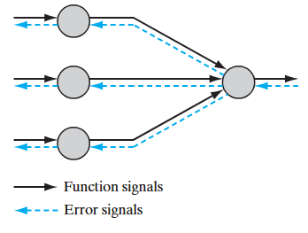
Multilayer Perceptron: Two kinds of Signal
Two kinds of signals are identified in Multilayer Perceptron network:
1. Function Signals. A function signal is an input signal (stimulus) that comes in at the input end of the network, propagates forward (neuron by neuron) through the network, and emerges at the output end of the network as an output signal. We refer to such a signal as a “function signal” for two reasons. First, it is presumed to perform a useful function at the output of the network. Second, at each neuron of the network through which a function signal passes, the signal is calculated as a
function of the inputs and associated weights applied to that neuron. The function signal is also referred to as the input signal.
2. Error Signals. An error signal originates at an output neuron of the network and propagates backward (layer by layer) through the network. We refer to it as an “error signal” because its computation by every neuron of the network involves an error-dependent function in one form or another

Slide 11
Batch learning and Online Learning

Slide 12
Question: Batch and Online learning
Evaluate how batch and online learning impact convergence rate, generalization capability, and computational performance
How do batch learning and on-line learning differ in terms of synaptic weight adjustments in a multilayer perceptron, and what are the advantages associated with each method?

Slide 13
MLP or Neural Network: Training process
The neural network needs to be trained in order to work. Its training process is in the context of supervised machine learning, where each data sample has a label informing to which class it belongs to. Thus, the general idea is to make the network able to learn the patterns relative to each class of objects we have, so when a new unknown sample of data is given to the network, it will be able to predict to which class that sample belongs to. How can this be done?
The idea of the backpropagation algorithm is, based on error (or loss) calculation, to recalculate the weights array w in the last neuron layer, and proceed this way towards the previous layers, from back to front, that is, to update all the weights w in each layer, from the last one until reaching the input layer of the network, for this doing the backpropagation of the error obtained by the network. In other words, we calculate the error between what the network predicted to be and what it was indeed, then we recalculate all the weights values, from the last layer to the very first one, always intending to decrease the neural network error.

Slide 14
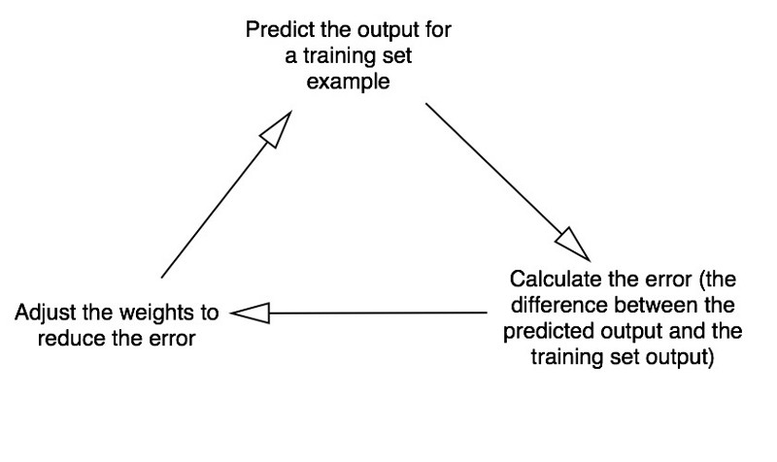
MLP or Neural Network: Training process
Forward Propagation
Backward Propagation

Slide 15
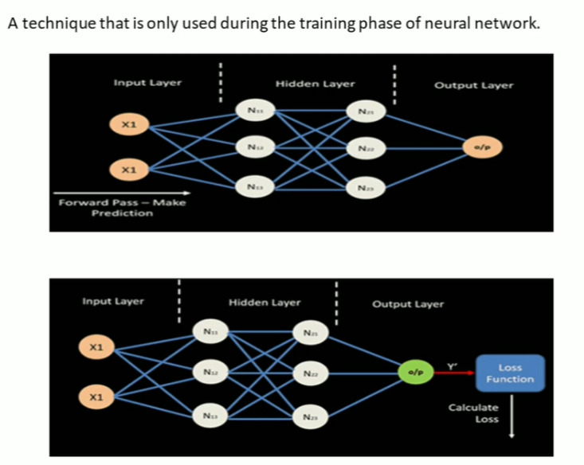
Backpropagation
Notes:
A technique that is only used during training phase of neural network.

Slide 16
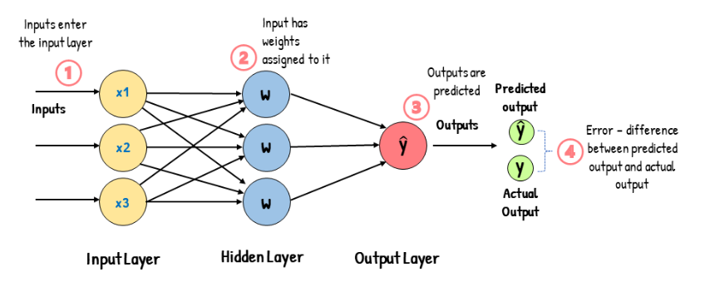
How Backpropagation works?
Backpropagation: A technique that is only used during training phase of neural network.

Slide 17
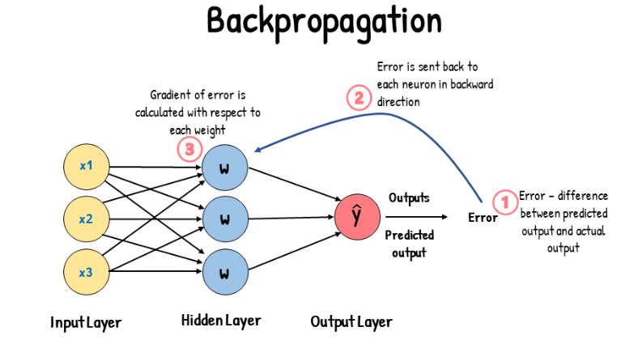

Slide 18
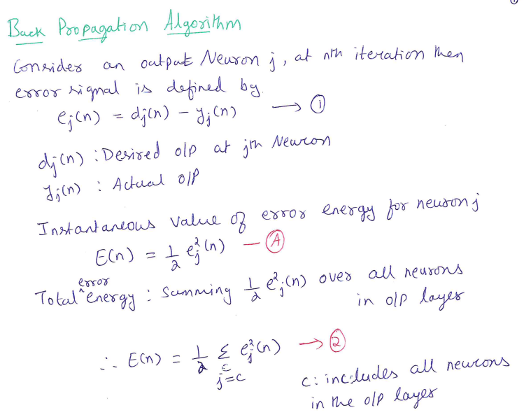

Slide 19
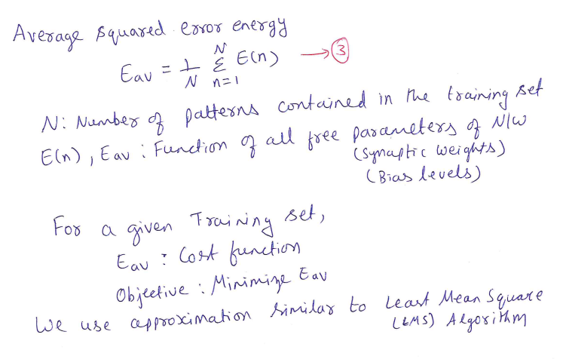
Back Propagation Algorithm

Slide 20
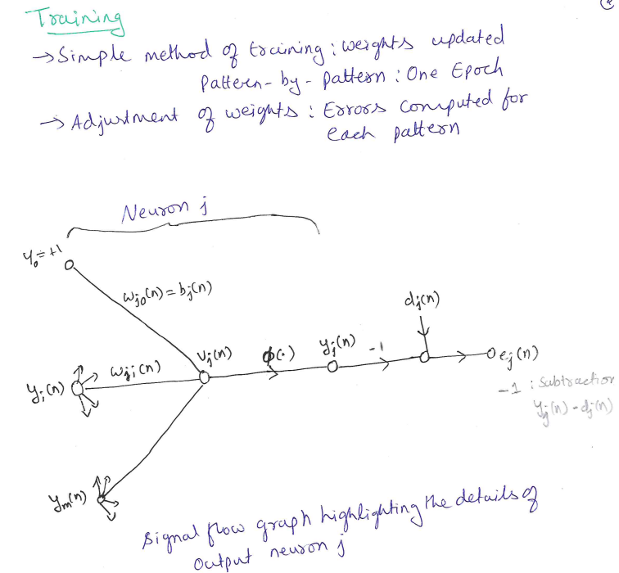
Back Propagation Algorithm

Slide 21
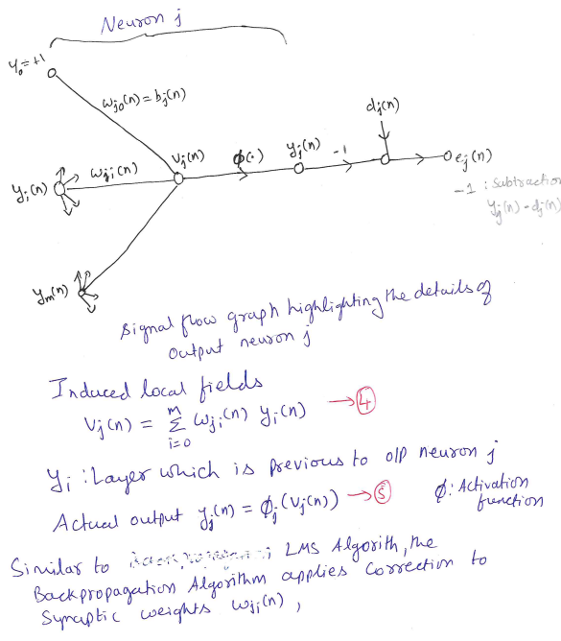
Back Propagation Algorithm

Slide 22
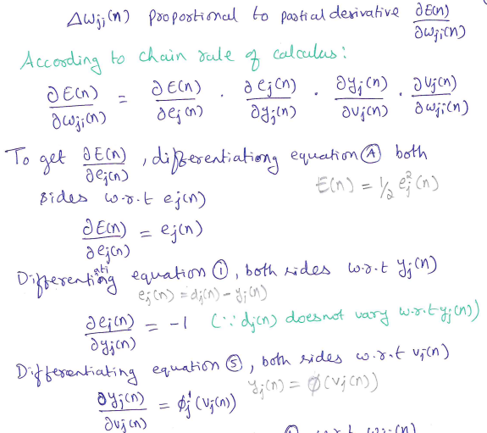
Back Propagation Algorithm

Slide 23
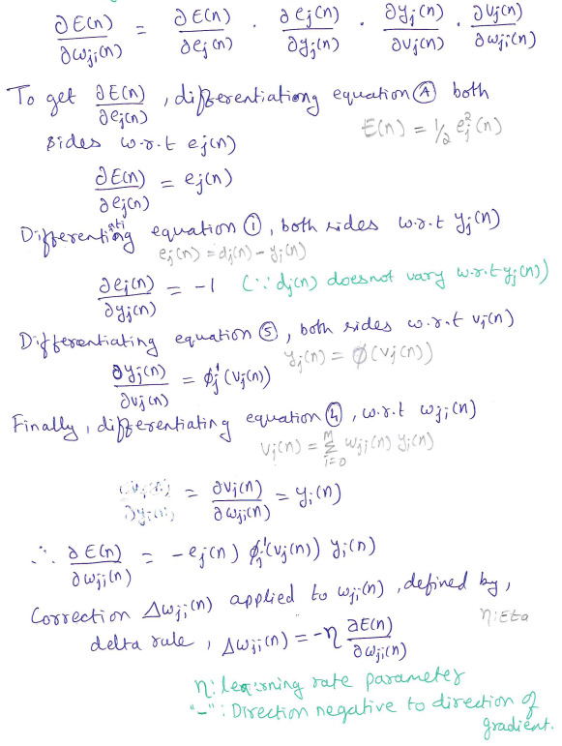
Back Propagation Algorithm

Slide 24
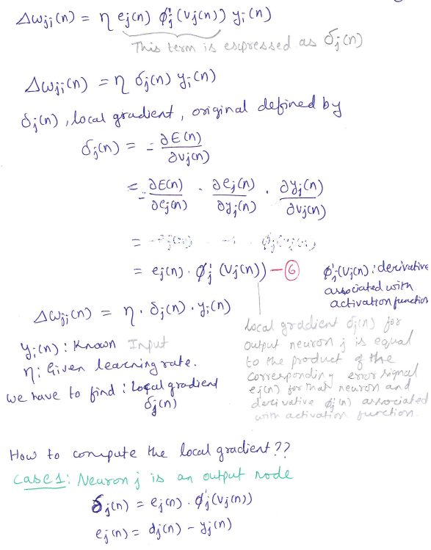
Back Propagation Algorithm

Slide 25
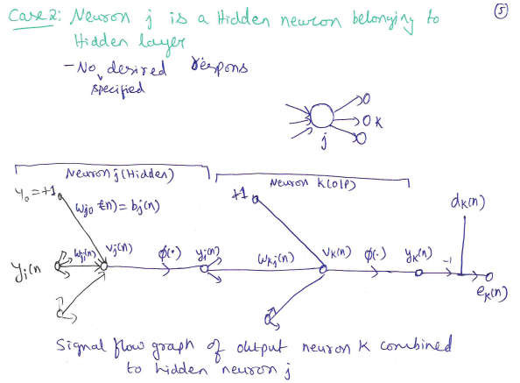
Back Propagation Algorithm

Slide 26
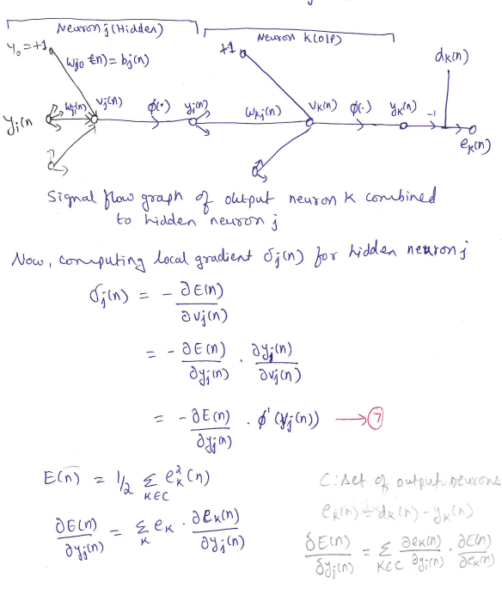
Back Propagation Algorithm

Slide 27
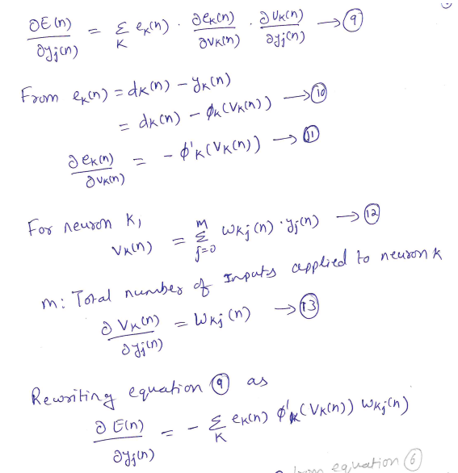
Back Propagation Algorithm

Slide 28
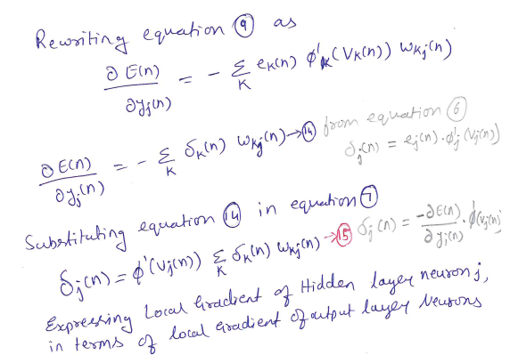
Back Propagation Algorithm

Slide 29
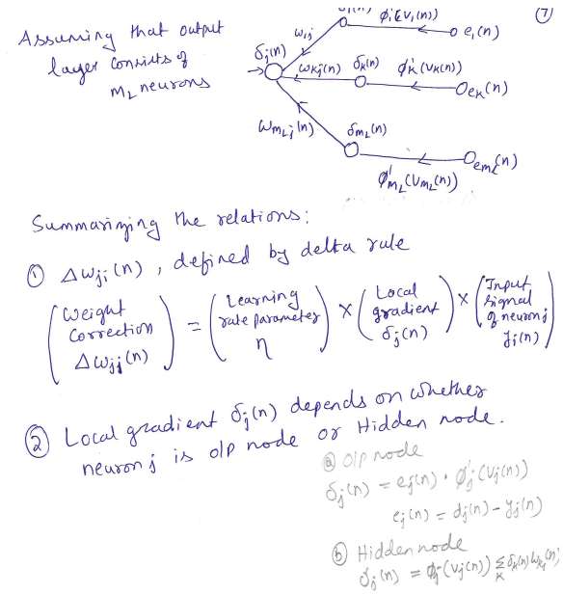
Back Propagation Algorithm

Slide 30
Question: Back Propagation algorithm
Derive the expression for the local gradient δj(n) used to change the synaptic weights in the backpropagation algorithm.
Derive the local gradient expressions for Neuron j as an output node and as a hidden node, detailing the differences in their calculations

Slide 31
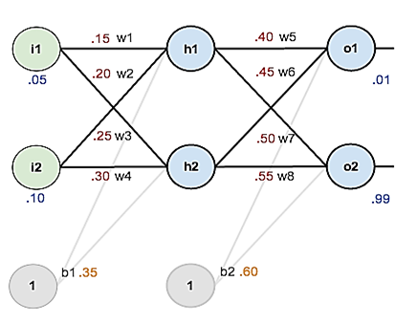
Question:Back Propagation algorithm
Consider the network given below apply the backpropagation algorithm to update the weights w1- w8 to obtain the output expected output with the learning rate 0.5. Use sigmoid activation function to train the network.
Neural Network: 2 inputs, 2 hidden neurons,
2 output Neurons

Slide 32
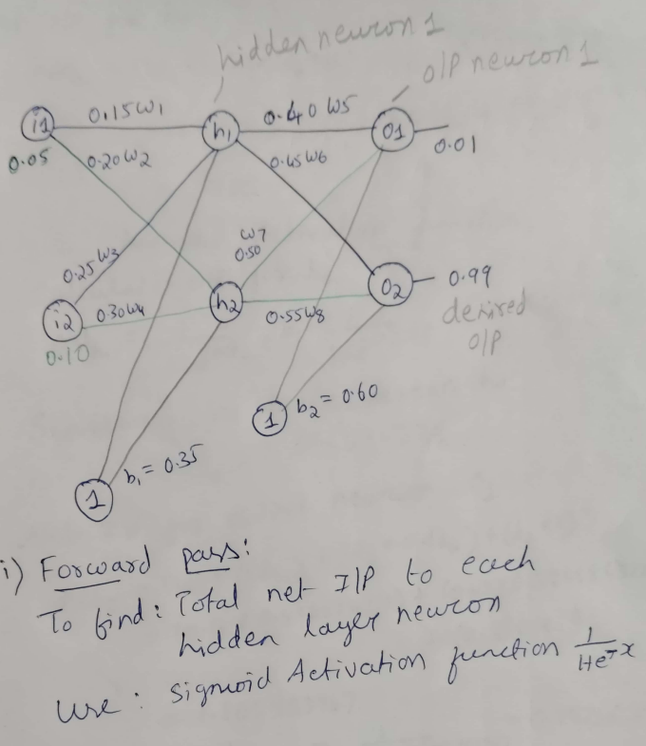
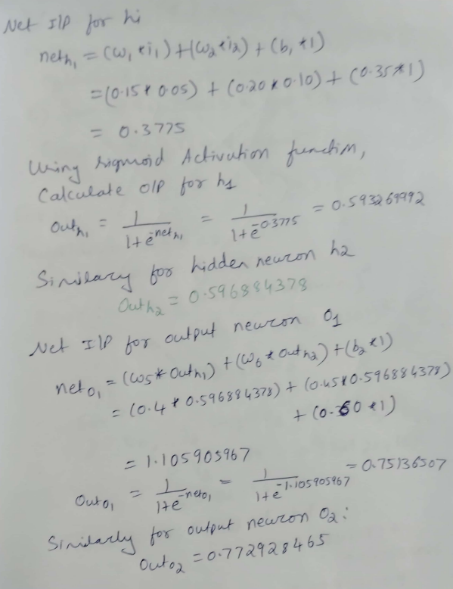

Slide 33
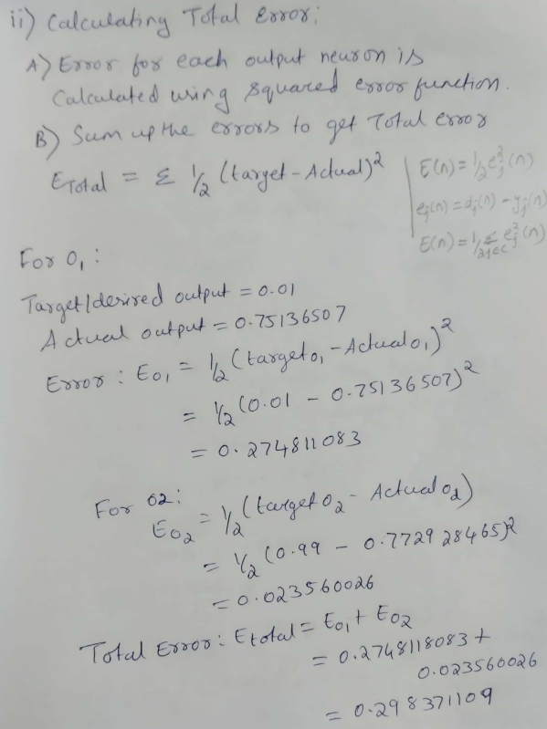
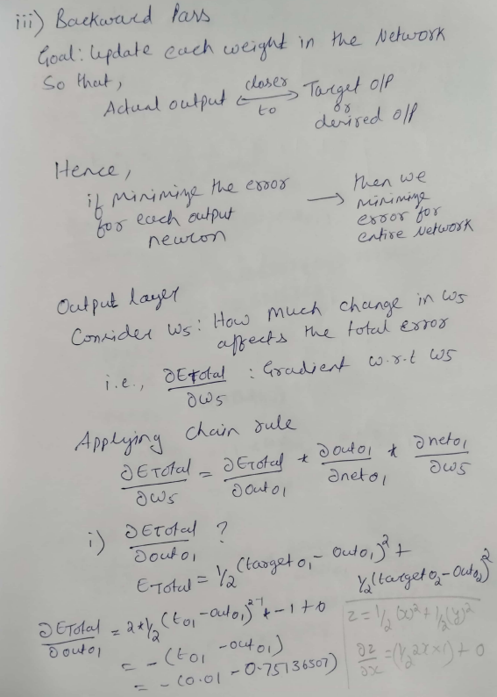

Slide 34
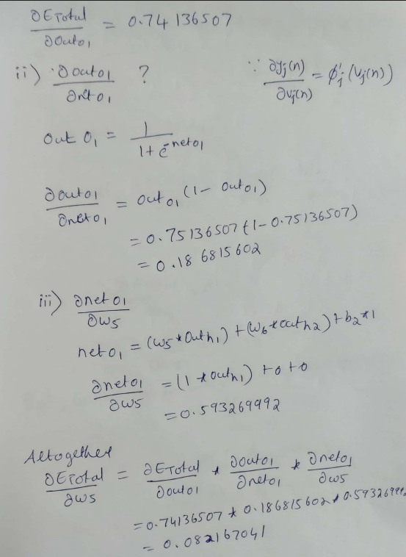
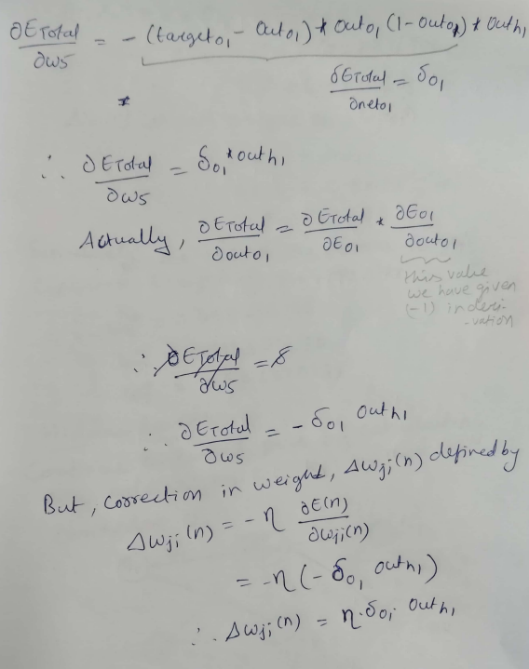

Slide 35
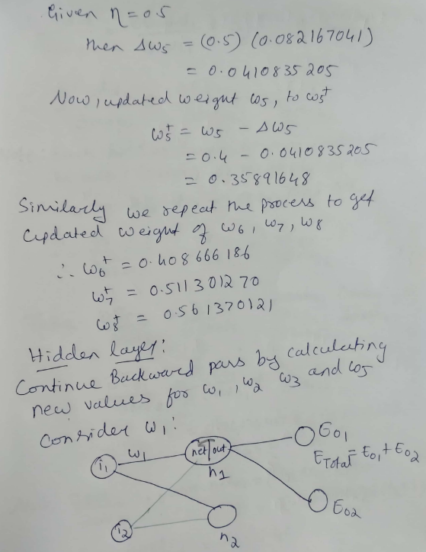
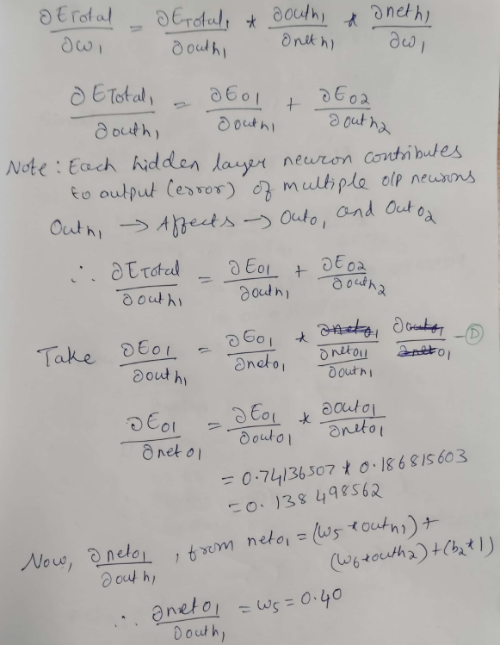

Slide 36
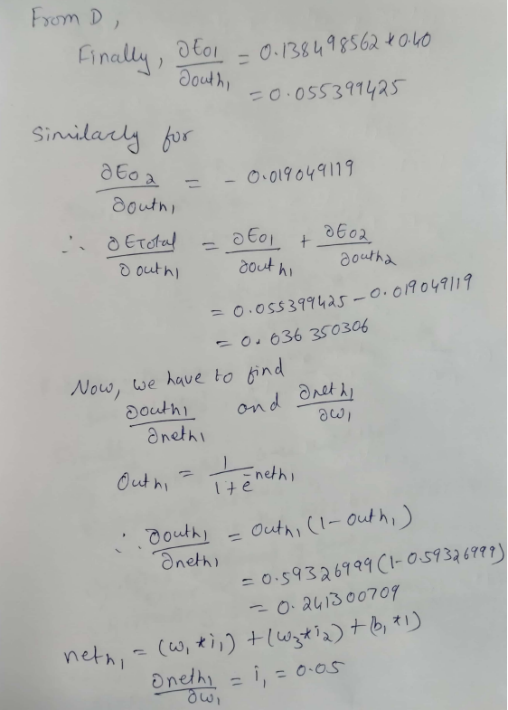
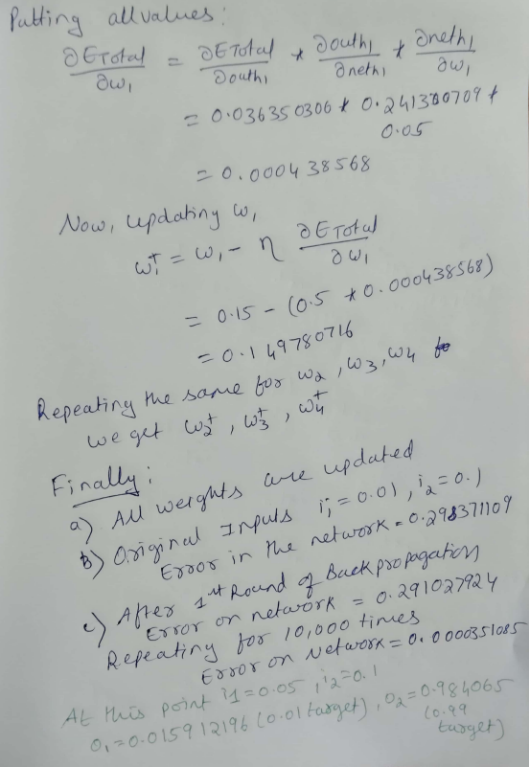

Slide 37
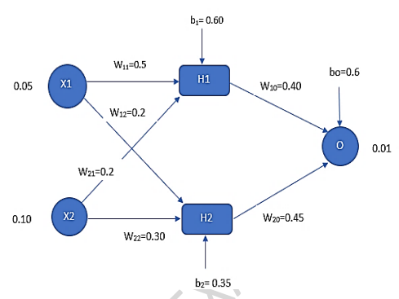
Question: Back Propagation algorithm
Consider a multilayer feed-forward neural network given below. Let the learning rate be 0.5. Assume initial values of weights and biases as given in the figure below. Show weight and bias updates by using back-propagation algorithm. Assume that sigmoid activation function is used in the network.

Slide 38
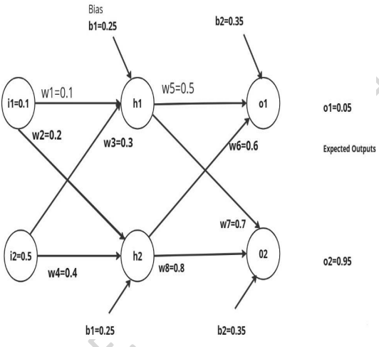
Question: Back Propagation algorithm
Apply the backpropagation algorithm for the network given below to update the weights w1- w8 to obtain the expected output with the learning rate 0.6. Use sigmoid activation function to train the network. In the network, i1, i2 are input layer neurons, h1 and h2 in hidden layer neurons and o1 and o2 are output layer neurons.

Slide 39
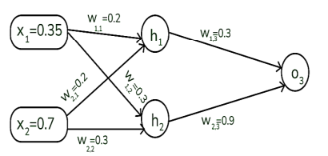
Question: Back Propagation algorithm
Assume that the neurons have the sigmoid activation function to perform forward and backward pass on the network. And also assume that the actual output of y is 0.5 and the learning rate is 1. Show weight updates by using back-propagation algorithm.

Slide 40
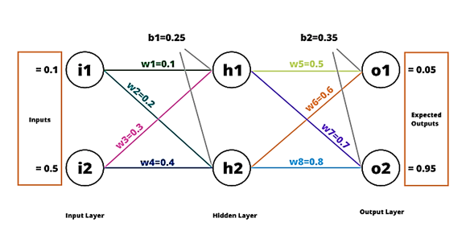
Question:Back Propagation algorithm
Consider the network given below apply the backpropagation algorithm to update the weights w1- w8 to obtain the output expected output with the learning rate 0.6. Use sigmoid activation function to train the network.

Slide 41
Question: Hessian and its role in online learning
Analyse the role of Hessian and its composition of the eigen values, factors effecting the eigen value in the multilayer perceptron trained with the backpropagation algorithm.
What is the role of the Hessian in study of neural networks, how does avoiding nonzero-mean inputs impact the learning process, and what is the importance of asymptotic behavior of assuming a fixed learning-rate parameter?

Slide 42
Question: Approximation functions
Derive an expression for the Universal approximation theorem for a nonlinear input -output mapping.

Slide 43
Question: Cross Validation
Write the algorithm for stratified k-Fold cross-validation

Slide 44
Question: Supervised Learning viewed as an Optimization
Derive the steps in applying the Conjugate Gradient Method and Quasi Newton method for the supervised training of a multilayer perceptron.
How training differs from pure optimization ? Write the process to minimize the average training error.
Show that the supervised learning can be viewed as an optimization problem by summarizing the steps involved in the Nonlinear Conjugate gradient method and Quasi-Newton Method.

Slide 45
Question: Non-linear filtering
What is nonlinear filtering? Illustrate the two basic ways where time may be built into the operation of a neural network. With a neat block diagram, describe the cascade connection of two subsystems: short-term memory and a static neural network.

Slide 46
Analyze how time can be incorporated into the operation of a neural network to enable temporal pattern recognition and what are the two basic ways this can be achieved. With the block diagram of a discrete-time memory structure consisting of p identical sections connected in cascade, derive an equation for memory depth D.

Slide 47
Question: Multilayer Perceptron
Derive the steps in applying the Conjugate Gradient Method and Quasi Newton method for the supervised training of a multilayer perceptron.
Explain the three basic features of the multilayer perceptron and the two phases of training by back-propagation algorithm with LMS as a special case.

Slide 48
Thanks for Listening

